Slide 1



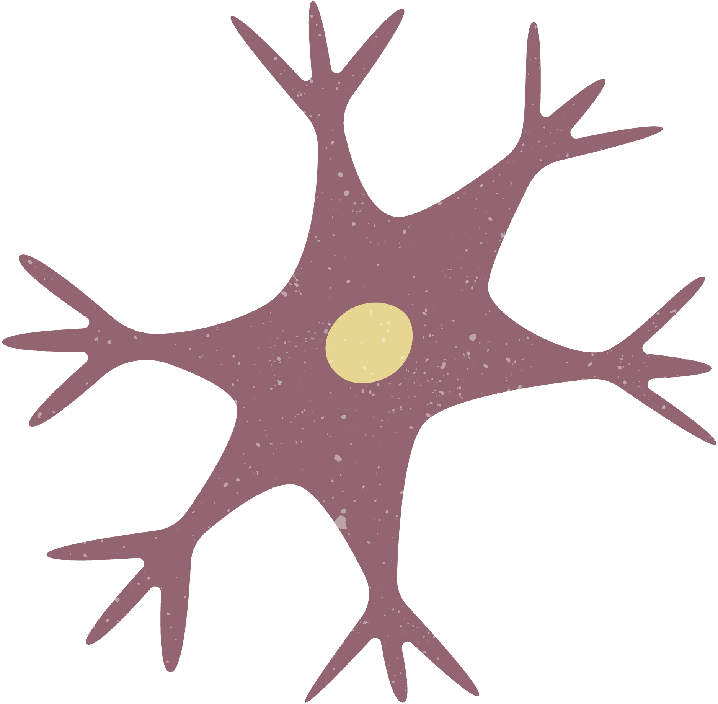
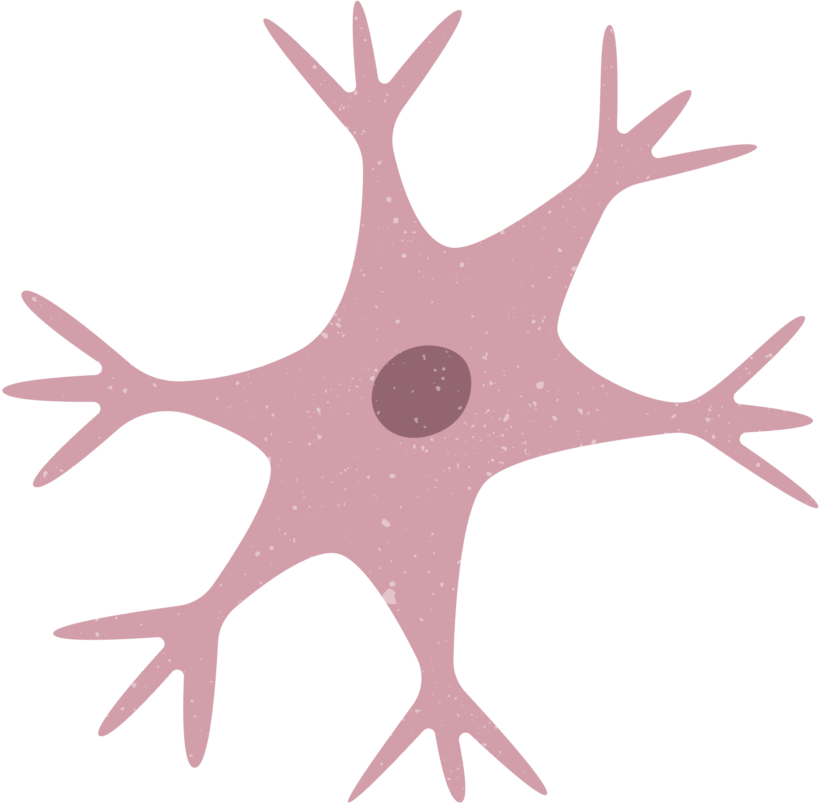
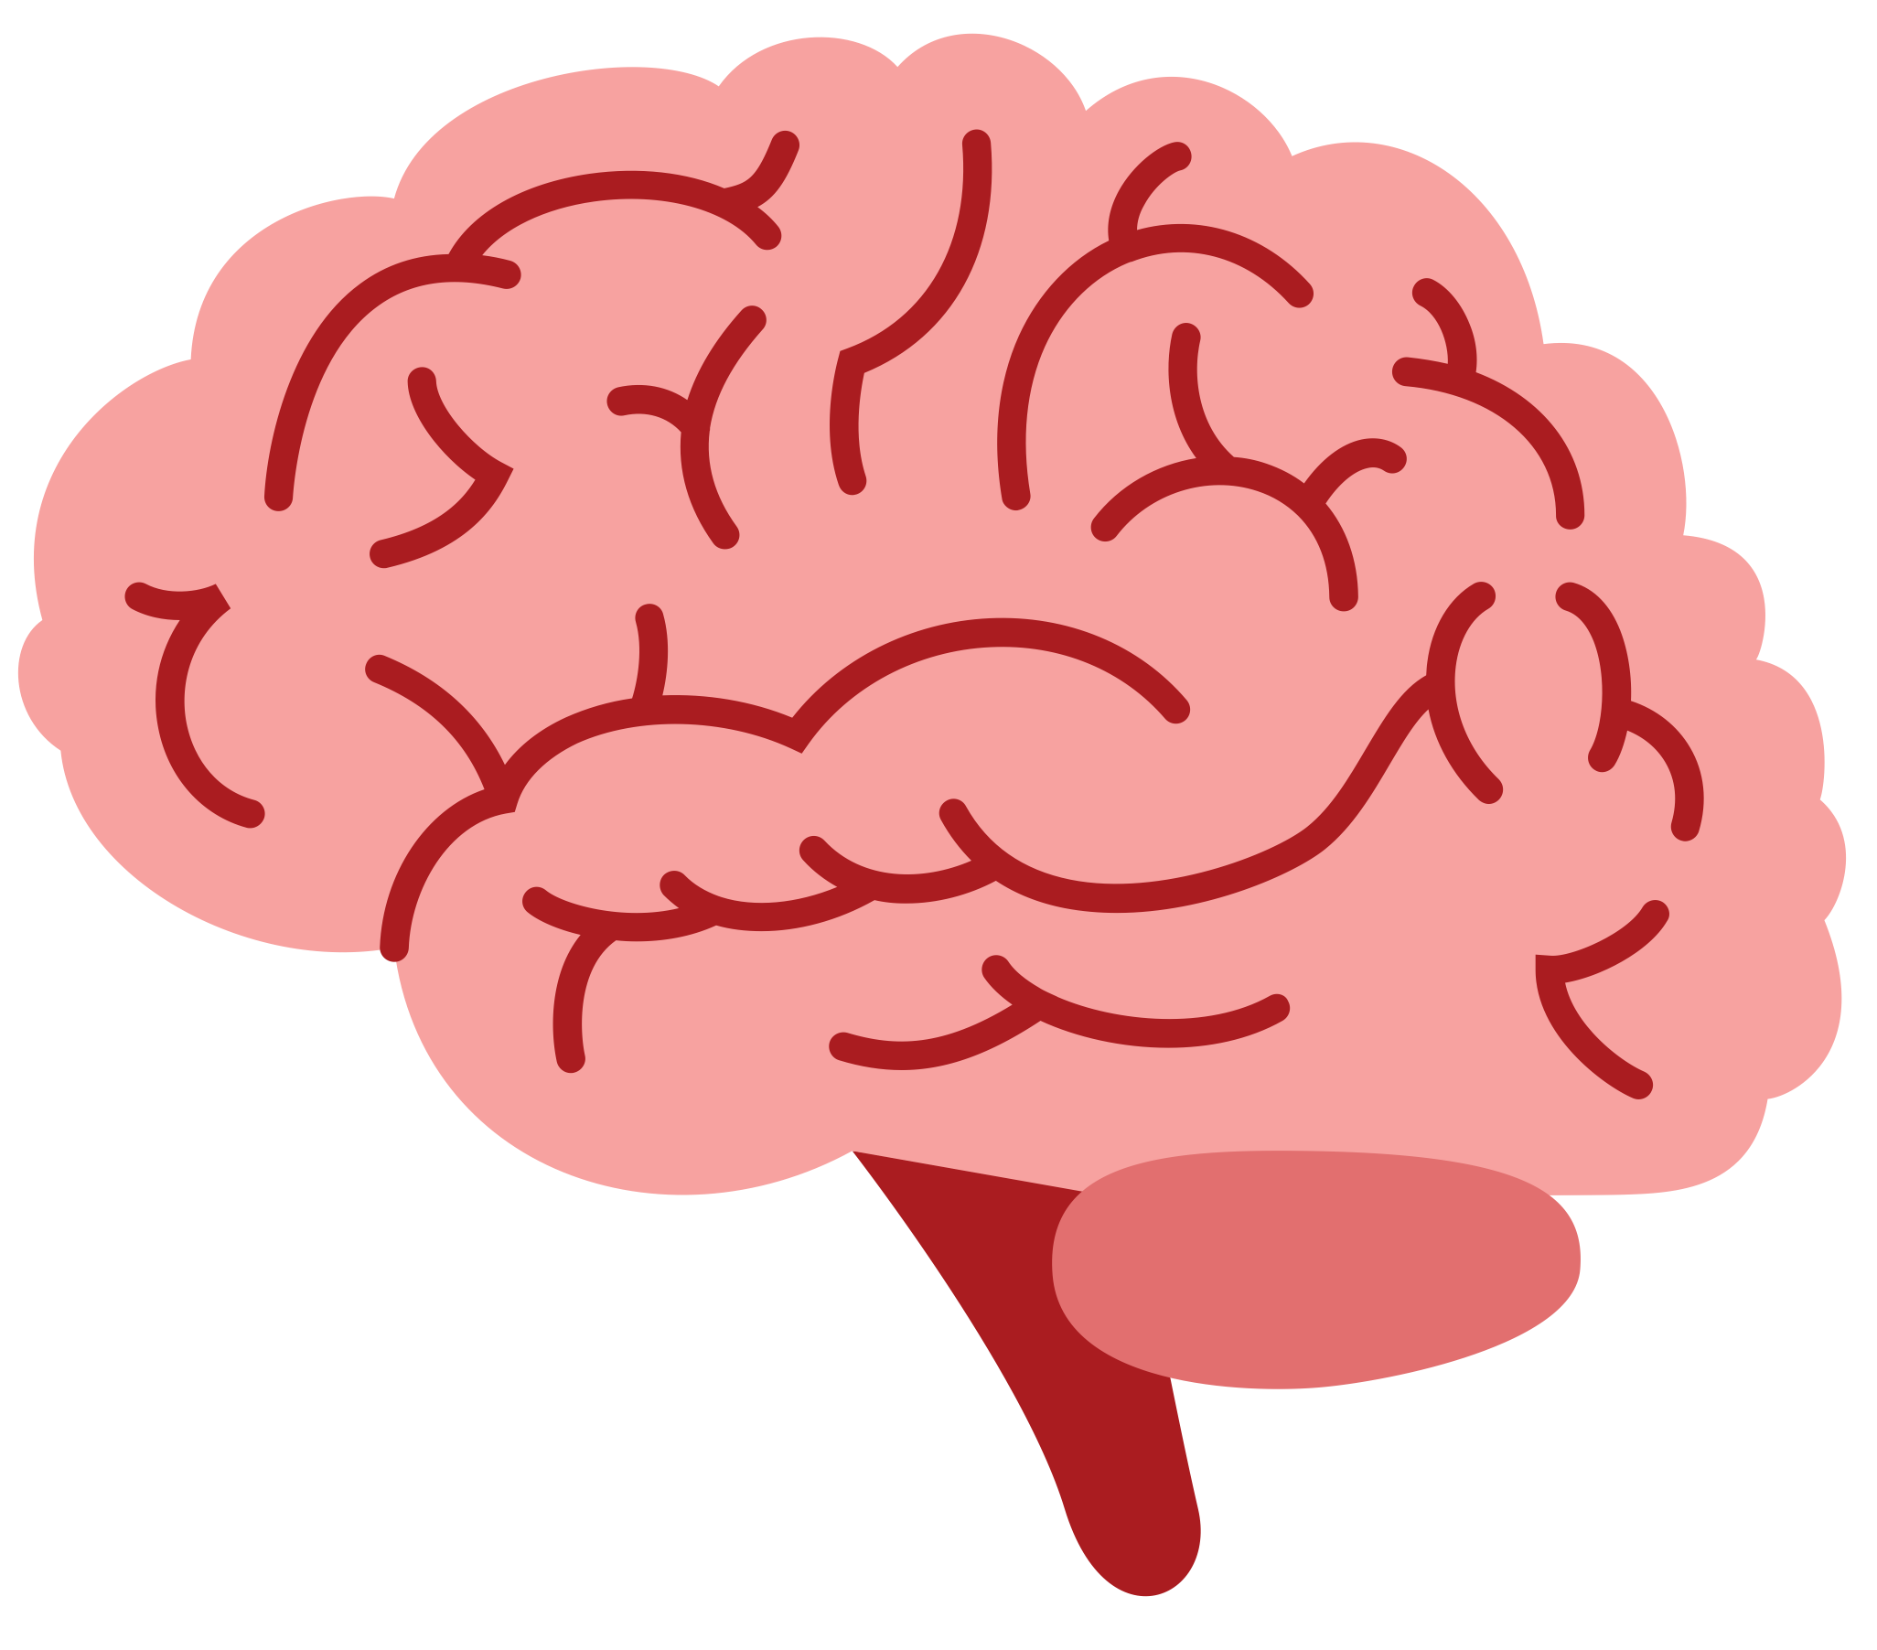
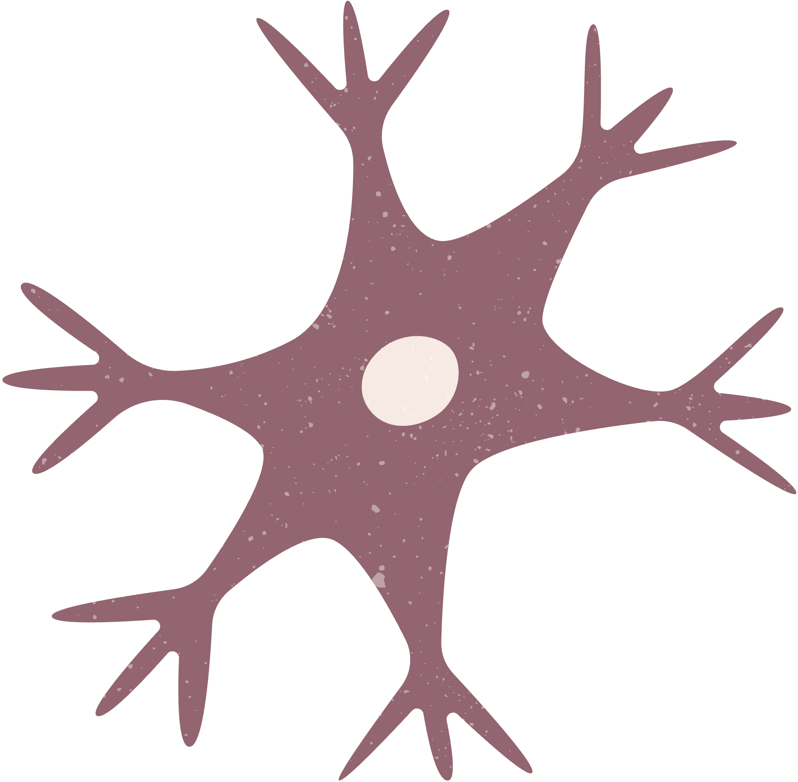
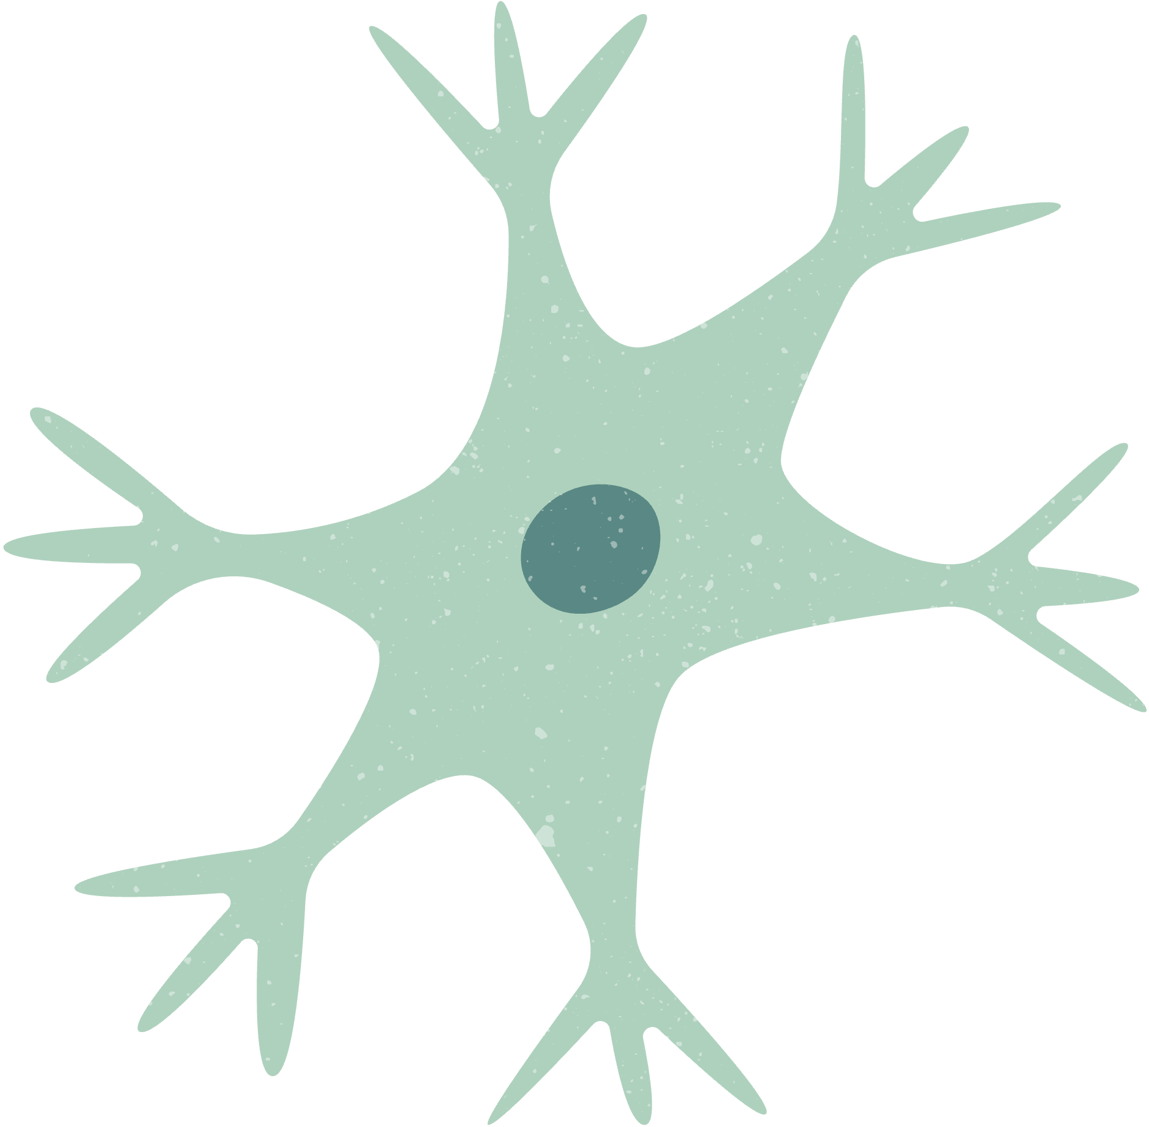
Incipient stage of Alzheimer’s
ADITYA PATWARDHAN
JOAN MATTLE
YAGAZIE AKWADA
AIZHAN UTEUBAYEVA

Slide 2


alzheimer’s disease
01
PROGRESSIVE AND IRREVERABLE
affecting memory, thinking, and behaviour
02
ABNORMAL PROTEIN DEPOSITS
gradual deterioration of cognitive and functional abilities
03
NO KNOWN CURE
that typically worsens over time

Slide 3
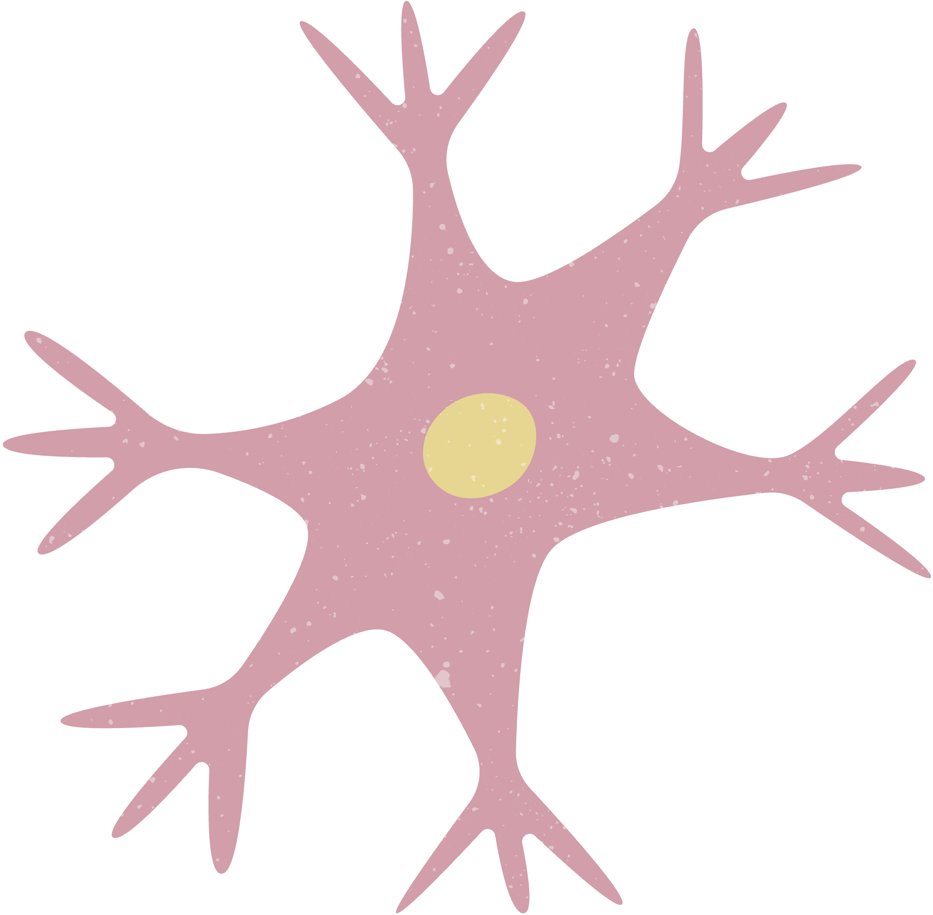


INCIPIENT STAGE
THE ONSET STAGE OF ALZHEIMER”S
WITH COMMON CHALLANGE SUCH AS:
right words
performing tasks
losing or misplacing object
trouble with planning or organizing

Slide 4
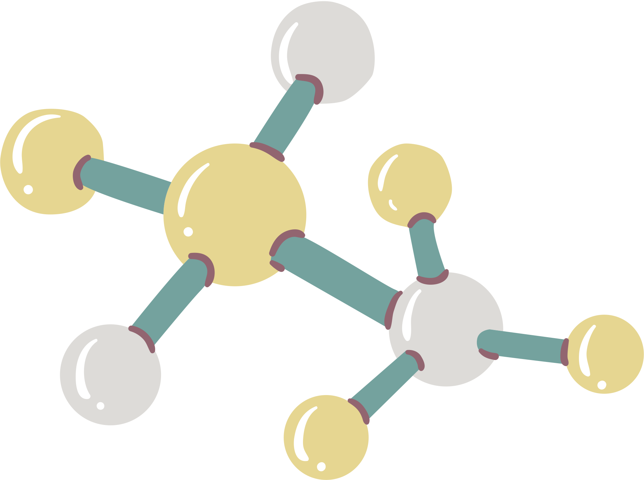





METHODS

Slide 5

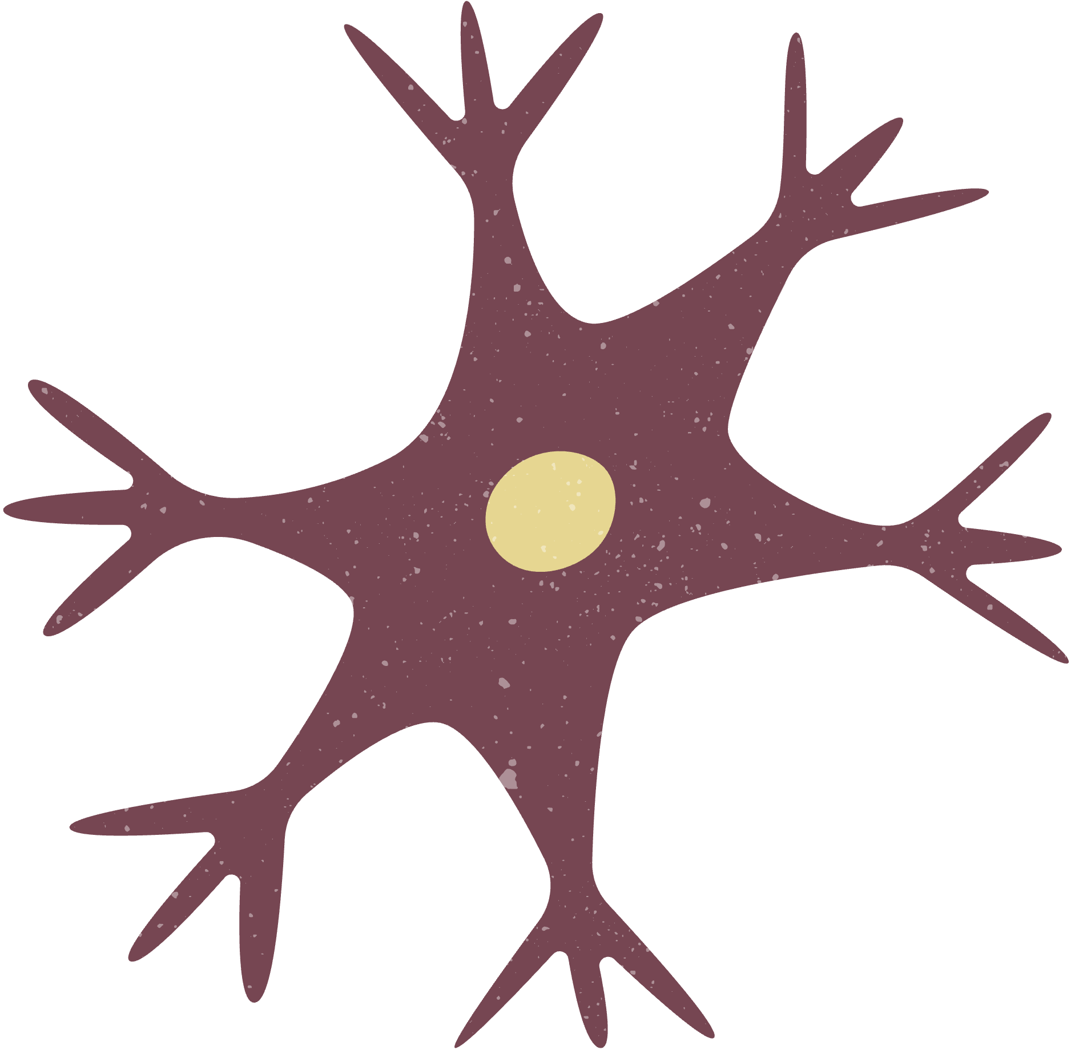
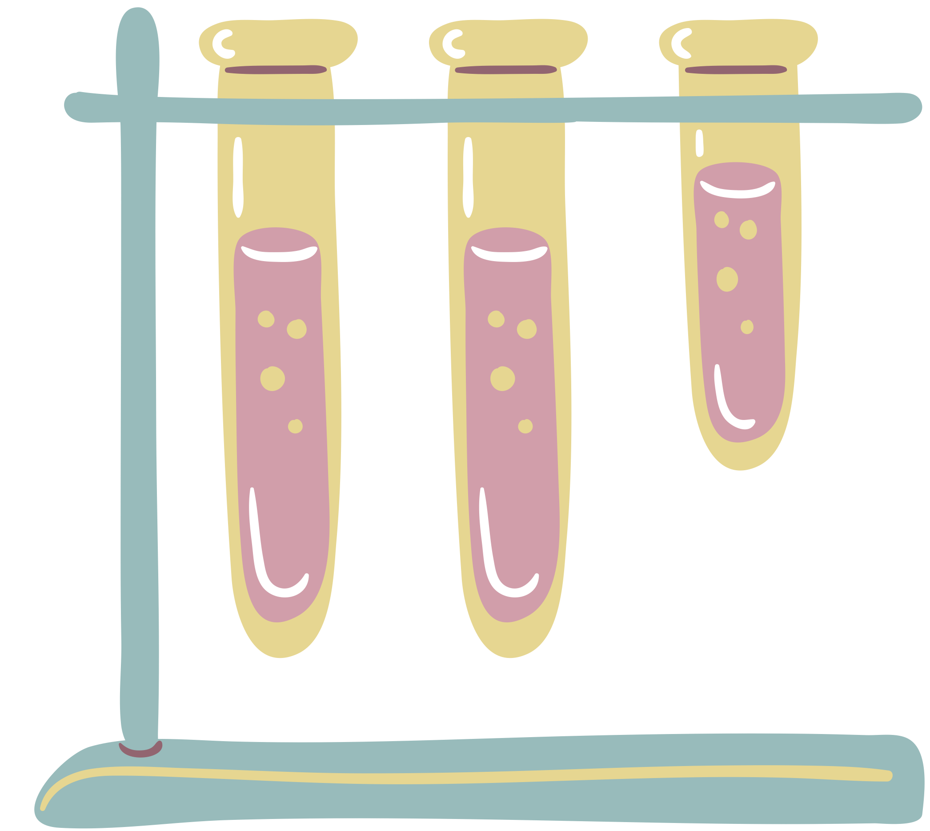
01
DATA ANALYSIS
Read in processed normalized gene expression data in log2 scale,
Gene annotation
Clean & Processed data
Baseline VS Incipient
02
DEGS & PATHWAYS
t-test (p-value < 0.01)
289 differentially expressed unique genes
EnrichR package
GO and KEGG (p-value < 0.01)

Slide 6
IMMUNE SYSTEM
CYTOSKELETON
REGULATION
DNA DAMAGE

Slide 7

actin polymerisation
interleukin-12
interleukin-6
collagen
IMMUNE SYSTEM
CYTOSKELETON
REGULATION
DNA DAMAGE
chromosome segregation
protein polymerisation
glutamate
mediators

Slide 8



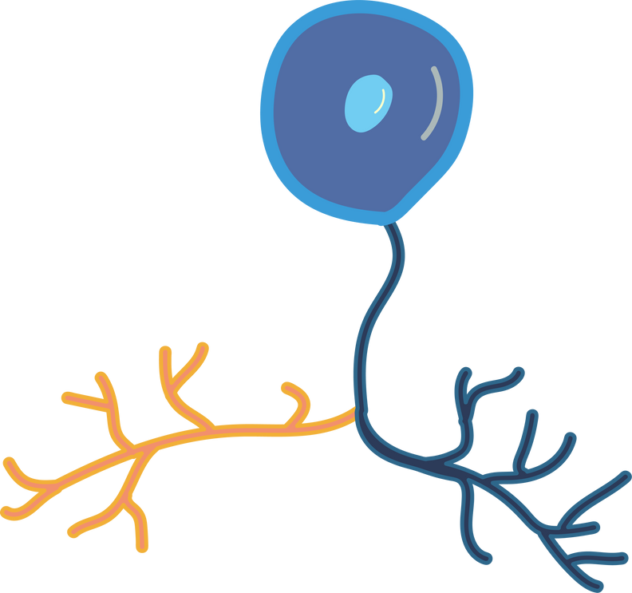
EPIGENETICS & BIOCHEMICAL CHANGES
(1)
ALTERATION OF THE BLOOD BRAIN BARRIER
(3)
(2)
IMMUNE SYSTEM RESPONSE & INFLAMMATION
AMELOYID BUILD-UP & A
NEURONAL DNA-LEVEL CHANGES
(5)
(4)

Slide 9

01
EPIGENETICS & BIOCHEMICAL CHANGES
HHIP
MAZ
INPPL1
Hypoacetylation
(altering the function of proteins or genes)
Methylation
(hypo vs hyper methylation)
Inositol phosphate phosphatases (crucial role in cellular signaling pathways. )

Slide 10

WASF1
JAK2
MEFV
Immune response
Neuronal function
Cell surface receptor
Gene expression
Inositol phosphate phosphatases (crucial role in cellular signaling pathways. )
02
IMMUNE SYSTEM RESPONSE & INFLAMMATION

Slide 11

ALTERED BLOOD
BRAIN BARRIER
03
CD47
APCDD1
DCN
Tissue integrity
Cellular processes
Hyper-permeability
of blood vessels
Blood vessel stress
response

Slide 12

04
NEURONAL DNA-LEVEL
DAMAGE
HIPK2
SUMO1
KCNAB1
Cellular homeostasis
DNA damage response
Cellular cycle
Stress response
Neuronal transmission regulation

Slide 13
05
HOW DOES THIS RELATE TO ALZHEIMER’S?
EPIGENETIS &
BIOCHEMICAL CHANGES
Hypoacetylation and methylation regulate function of the proteins and immune cells => further contibuting to AD
IMMUNE SYSTEM RESPONSE & INFLAMMATION
AD is associated with chronic neuroinflammation which potentially contributes to neuronal damage
BLOOD BRAIN
BARRIER
BBB serves as a protective barrier preventing harmful the entering of plasma-derived components, cells, and pathogens
NEURONAL DNA-LEVEL
DAMAGE
In AD, a common occurrence is DNA damage, with double-strand DNA breaks being especially problematic for neurons

Slide 14

MODERATE
TXNRD3
BSN
HIPKCNJ6
SERPINI1
HIPK2
DDR
KCNAB1
DCN
SUMO1
MEFV
APCDD1
GAP43
CAB39
SMAD4
WASF1
SEVERE
INCIPIENT

Slide 15

CONCLUSION
MULTI-STEP PROGRESSION OF THE DISEASE
investigating the onset revealed pleathora of pathways that could potentially contribute to the AD development
OVERLAPPING MECHANISMS AT ALL STAGES
potential target for treatment with precision health
FURTHER RESEARCH IS NEEDED
conduct further research with different sampling
and statistical methods

Slide 16
REFERENCES
Gheibihayat, S.M., Cabezas, R., Nikiforov, N.G., Jamialahmadi, T., Johnston, T.P., Sahebkar, A., 2021. CD47 in the Brain and Neurodegeneration: An Update on the Role in Neuroinflammatory Pathways. Molecules 26, 3943. https://doi.org/10.3390/molecules26133943
Jin, B., Fei, G., Sang, S., Zhong, C., 2023. Identification of biomarkers differentiating Alzheimer’s disease from other neurodegenerative diseases by integrated bioinformatic analysis and machine-learning strategies. Frontiers in Molecular Neuroscience 16.
Knock, E., Matsuzaki, S., Takamura, H., Satoh, K., Rooke, G., Han, K., Zhang, H., Staniszewski, A., Katayama, T., Arancio, O., Fraser, P.E., 2018. SUMO1 impact on Alzheimer disease pathology in an amyloid-depositing mouse model. Neurobiol Dis 110, 154–165. https://doi.org/10.1016/j.nbd.2017.11.015
Lohoff, F.W., Clarke, T.-K., Kaminsky, Z.A., Walker, R.M., Bermingham, M.L., Jung, J., Morris, S.W., Rosoff, D., Campbell, A., Barbu, M., Charlet, K., Adams, M., Lee, J., Howard, D.M., O’Connell, E.M., Whalley, H., Porteous, D.J., McIntosh, A.M., Evans, K.L., 2022. Epigenome-wide association study of alcohol consumption in N = 8161 individuals and relevance to alcohol use disorder pathophysiology: identification of the cystine/glutamate transporter SLC7A11 as a top target. Mol Psychiatry 27, 1754–1764. https://doi.org/10.1038/s41380-021-01378-6
Montagne, A., Zhao, Z., Zlokovic, B.V., 2017. Alzheimer’s disease: A matter of blood–brain barrier dysfunction? Journal of Experimental Medicine 214, 3151–3169. https://doi.org/10.1084/jem.20171406
Perner, F., Perner, C., Ernst, T., Heidel, F.H., 2019. Roles of JAK2 in Aging, Inflammation, Hematopoiesis and Malignant Transformation. Cells 8, 854. https://doi.org/10.3390/cells8080854
Wei, Y., Shin, M.R., Sesti, F., 2018. Oxidation of KCNB1 channels in the human brain and in mouse model of Alzheimer’s disease. Cell Death Dis 9, 820. https://doi.org/10.1038/s41419-018-0886-1
Zenaro, E., Piacentino, G., Constantin, G., 2017. The blood-brain barrier in Alzheimer’s disease. Neurobiol Dis 107, 41–56. https://doi.org/10.1016/j.nbd.2016.07.007

Slide 17

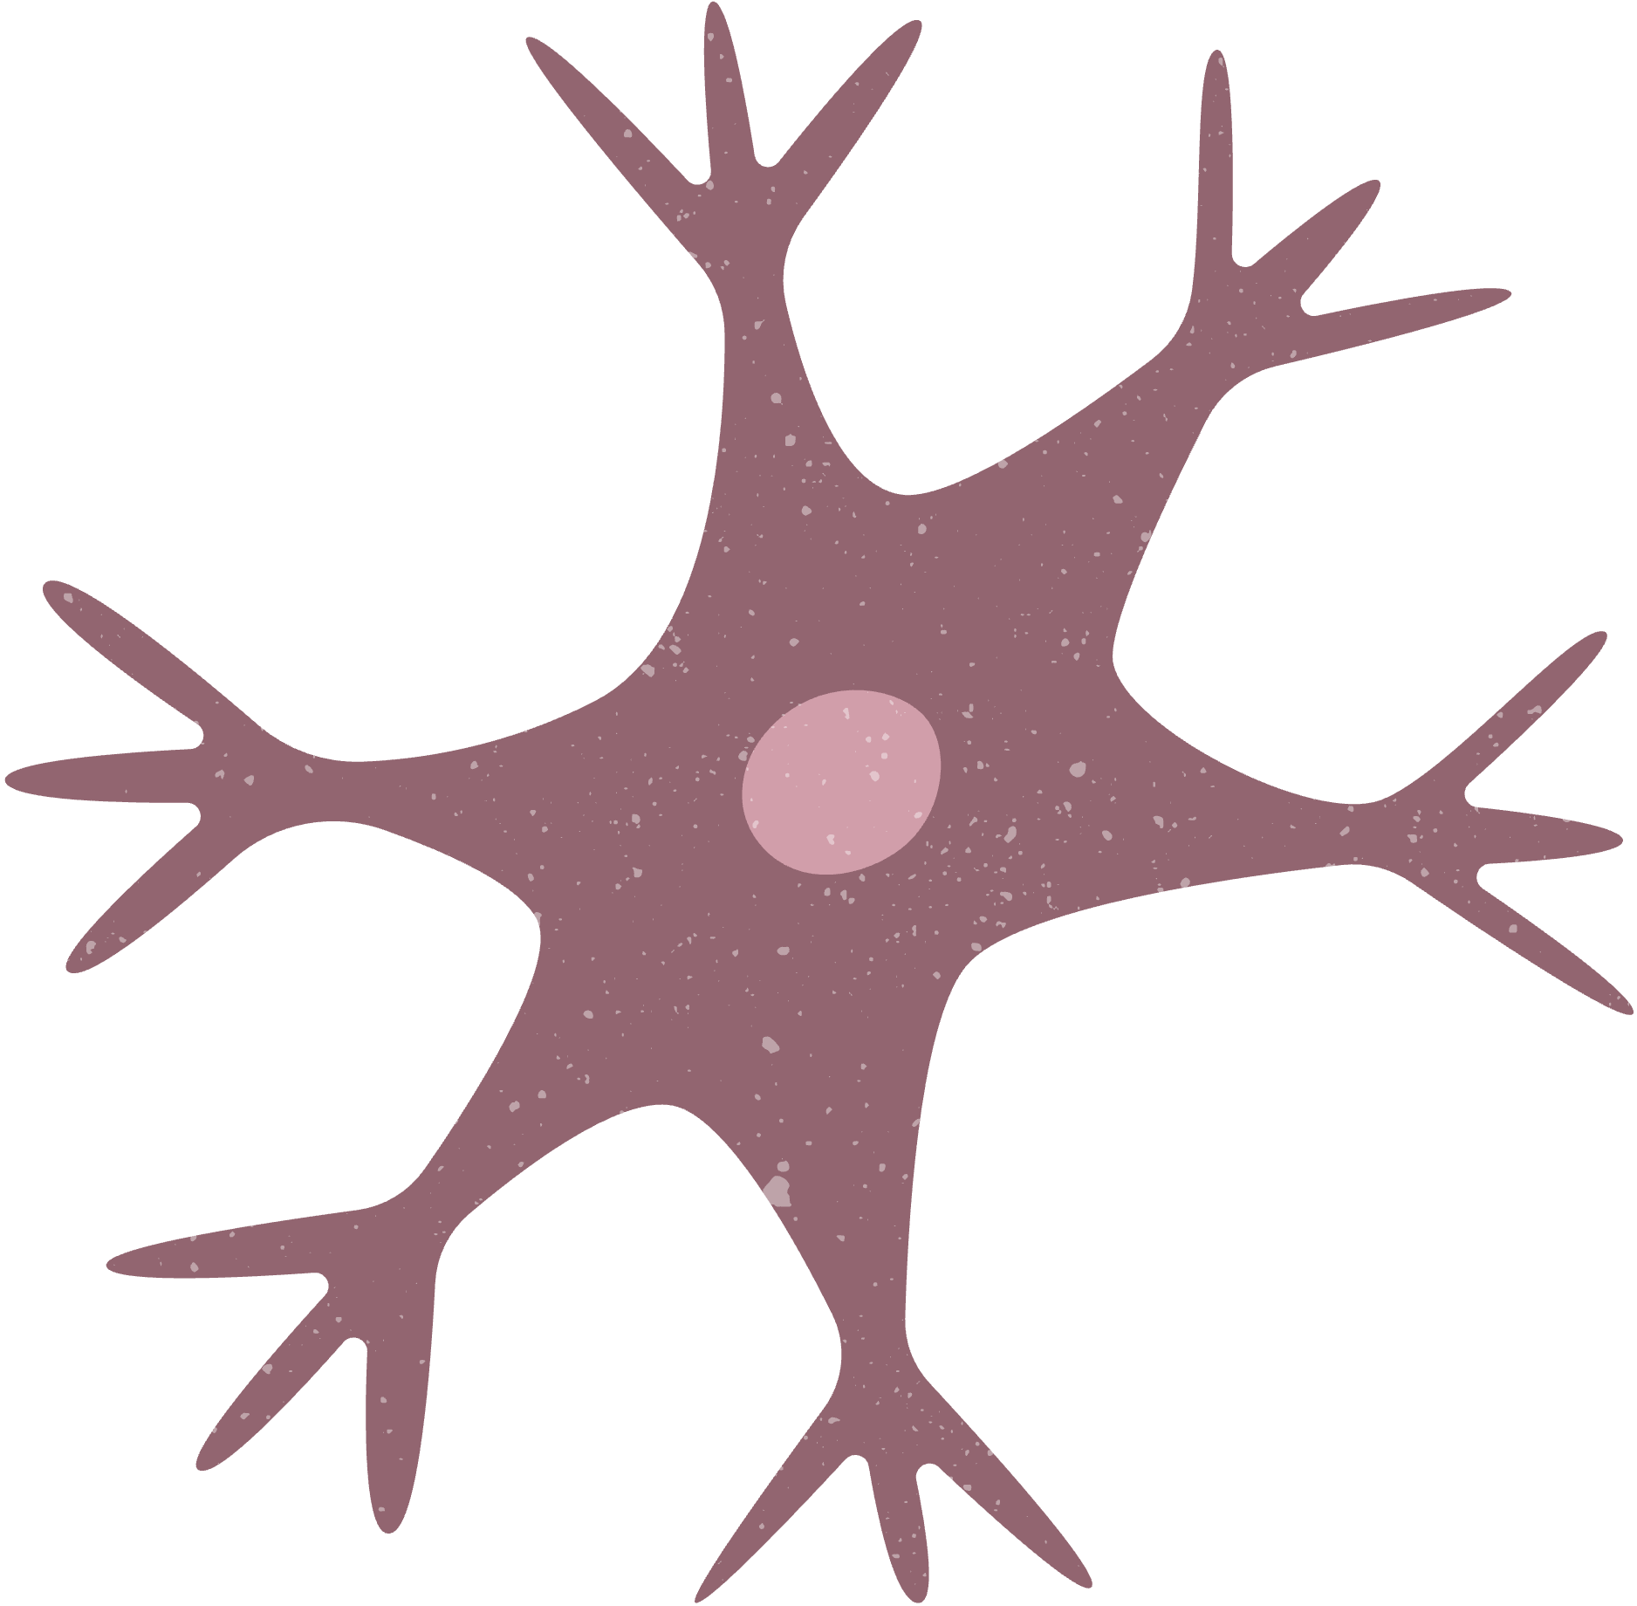

THANK YOU!

